Slide 1
Basic Web
Node Modules, MVC, Express.js, Handlebars
SoftUni Team
Technical Trainers
Software University
https://softuni.bg

Slide 2
Table of Contents
Node modules
HTTP
Create a simple HTTP Server
Express.js Framework
Model-View-Controller (MVC)
MVC with Node, Express.js, Handlebars

Slide 3
Have a Question?
sli.do
#fund-js

Slide 4
Node Modules
module
.exports
Create a Basic Web Server

Slide 5
Modules
Allow larger apps to be split and organized
Node.js includes three types of modules
Core Modules
Local Modules
Third Party Modules

Slide 6
Local Modules
Created locally in the Node.js application
Include different functionalities in separate folders
Use module.exports to expose a function, object or variable
Loaded using the require() function
module.exports = myModule
const myModule = require('./myModule.js');

Slide 7
Third-Party Modules
Installed from Node Package Manager (NPM)
Run from the terminal
To use in your code
To install globally (for use from the terminal)
npm install --save express --save-exact
const express = require('express');
npm install expess-handlebars
7

Slide 8
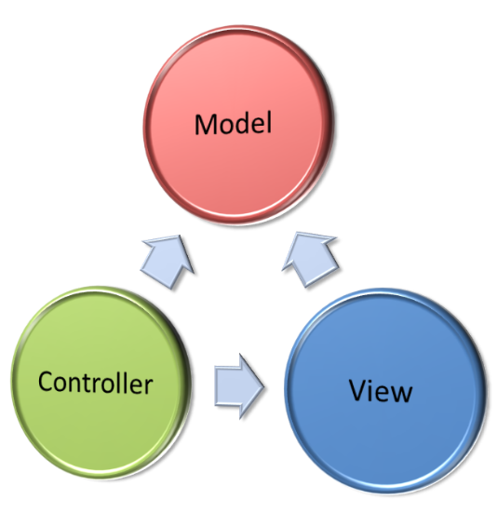
Model-View-Controller
The MVC Pattern

Slide 9
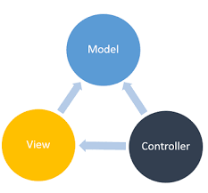
The MVC Pattern
Design pattern with three independent components
Model (data)
Manages data and database logic
View (UI)
Presentation layer (renders the UI)
Controller (logic)
Implements the application logic
Processes user request, performs an action, updates the data model and invokes a view to render some UI

Slide 10
Model (Data)
Set of classes that describes the data we are working with
Rules for how the data can be changed and manipulated
May contain data validation rules
Often encapsulates data stored in a database
As well as code used to manipulate the data

Slide 11

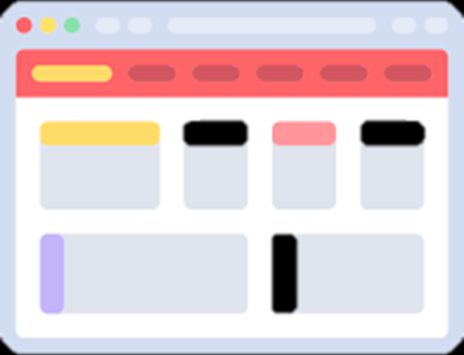

View (UI)
Defines how the application's user interface (UI) will be displayed
May support master views (layouts)
May support sub-views (partial views or controls)
May use templates to dynamically generate HTML

Slide 12

Controller (Logic)
The core MVC component – holds the logic
Process the requests with the help of views and models
A set of classes that handles
Communication from the user
Overall application flow
Application-specific logic (business logic)
Every controller has one or more "actions"

Slide 13
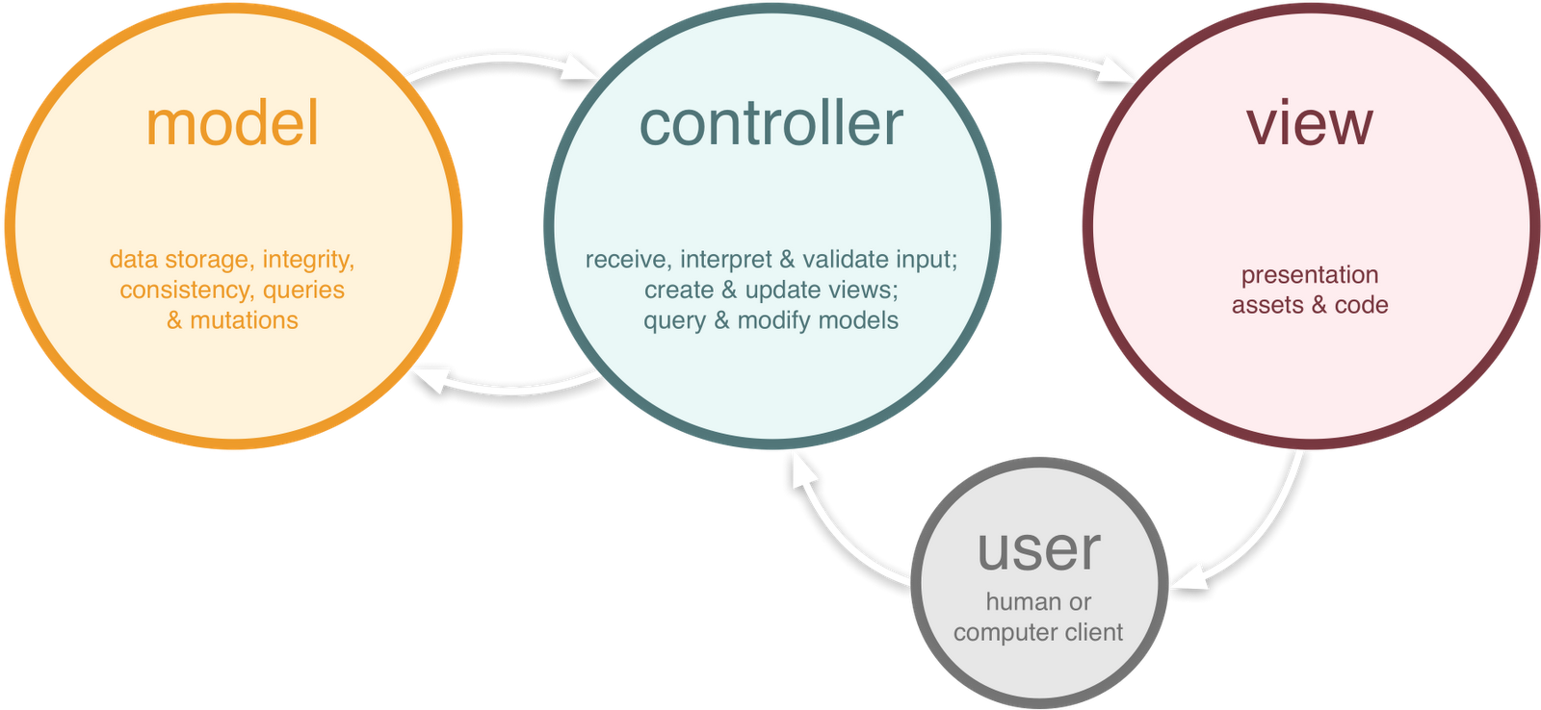
The MVC Pattern (in Web Apps)

Slide 14

Express.js
Working with a Framework

Slide 15


What is ExpressJS?
Web framework for Node.js
Handles GET / POST HTTP requests
Error handling (bad request, not found, unauthorized)
Routing supported
Define URL parameters
app.post('/users/:id', function (req, res) {})

Slide 16
Installation
Create a directory to hold your application
Create a package.json file that stores dependency information
Now install express inside the directory
mkdir demoapp
cd demoapp
npm init
Saves the dependency inside package.json
npm install express --save

Slide 17
Demo App
Create an index.js file
node index.js
const express = require('express');
const app = express();
const port = 3000;
app.get('/', function(req, res) {
res.send('Hello world!');
});
app.listen(port, () => console.log(`Example app listening on port: ${port}`));
The function handles HTTP GET requests at URL '/'

Slide 18
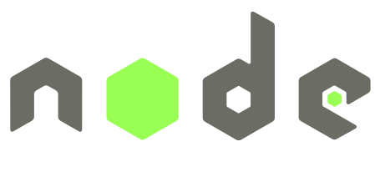

MVC with Express.js
Using Node.js, Express.js, Handlebars

Slide 19
Handlebars Templates
Handlebars provides the power necessary to let you build semantic templates effectively
To install it inside an Express.js project type in cmd:
npm install express-handlebars --save

Slide 20
View – Handlebars
HTML views with Handlebars templating syntax:
<div class="container body-content">
<div class="row">
<h2>{{cat.name}}</h2>
<p>Age: {{cat.age}}</p>
{{#if cat.isAlive}}
<p>Status: Alive</p>
{{else}}
<p>Status: Deceased</p>
{{/if}}
</div>
</div>
Handlebars
syntax
HTML Code
Handlebars
If/else

Slide 21
Setting Up Handlebars
const handlebars = require('express-handlebars');
app.engine('hbs', handlebars({
layoutsDir: 'views',
defaultLayout: 'main-layout',
partialsDir: 'views/partials',
extname: 'hbs'
}));
app.set('view engine', 'hbs');

Slide 22
Parsing Incoming Requests
Use express to parse incoming request bodies available under the req.body property
app.use(express.json())
app.use(express.urlencoded({ extended: true }))

Slide 23
ExpressJS Routing
Refers to determining how an application responds to a client request to a particular endpoint
Express executes different functions, based on route:
Specify HTTP Request method (GET / POST)
Function to execute when the route is matched
app.get('/api/todos', function(req, res) {})
Express instance
URL (path on server)
Request & Response

Slide 24
Handle Different HTTP Methods
Routing in express gives you the ability to handle different HTTP requests
app.post('/login', function(req, res) {})
app.put('/books/:id', function(req, res) {})
app.delete('/books/:id', function(req, res) {})

Slide 25
Working with URL Parameters
You can get a URL parameter from req.params
Chaining multiple parameters
app.get('/books/:id', function(req, res) {
let bookId = req.params.id;
console.log(bookId);
});
app.get('/user/:first/:second', function(req, res) {
console.log([req.params.first, req.params.second]);
});

Slide 26

Summary
…
…
…
Node.js – JavaScript runtime environment
We use Node and HTTP to create servers
MVC is a design pattern with individual components
Express.js – Web Framework for building server-side JavaScript apps

Slide 27
Questions?
Notes:
27

Slide 28
Trainings @ Software University (SoftUni)
Software University – High-Quality Education, Profession and Job for Software Developers
softuni.bg
Software University Foundation
softuni.foundation
Software University @ Facebook
facebook.com/SoftwareUniversity
Software University Forums
forum.softuni.bg
Notes:
28

Slide 29

License
This course (slides, examples, demos, exercises, homework, documents, videos and other assets) is copyrighted content
Unauthorized copy, reproduction or use is illegal
© SoftUni – https://about.softuni.bg/
© Software University – https://softuni.bg
Notes:
29

